Slide 1

Debt Letters MVP
Interviews + Usability Topline Readout
Riley Orr & Rebecca Walsh
UX Designers
August 25, 2020

Slide 2
Interview Key Takeaways

Slide 3
Veterans reported that it’s difficult to get in touch with the right people to talk to about their VA debt
Debt Letters MVP Interviews
When calling to discuss their debt, participants reported that they’d be left on hold for up to an hour, transferred in a loop, and dropped.
Participants reported that they were unable to get the answers they needed by talking to DMC representatives.
One Veteran contacted their senator for help due to difficulty navigating his debt.
One Veteran could not interact with the VA due to having a fiduciary.
I've been in constant loops of having to talk to people and getting dropped... and the [45m-1h] wait time alone to talk to the VA is atrocious.
Sometimes it makes it that much worse when you're trying to talk to people and they don't have enough time in their day to talk to you.
It seems like the VA just wants to bounce me around from person to person...
I would do anything not to call the Debt Management Center.

Slide 4
2. Veterans often felt blindsided by their VA debt
Debt Letters MVP Interviews
Several participants said that it took a long time for an issue with their account to be caught, often resulting in a large and sudden debt.
Three participants felt they did everything right to avoid getting a debt, but ended up with one anyway.
Some Veterans didn’t realize that what they’d done would cause a debt.
It was unnecessary for the amount of time that had lapsed since the time the debt occurred. The VA should have stayed on top of it so I wouldn't incur any debt. Instead I got blindsided by it and I had to pay back a bunch of debt.
I lost faith in those [at my local VA] because they led me to believe it was perfect and it wasn’t.
I have a feeling like when you send things to VA, it just gets lost. I did everything on my part to make a debt accumulate and I still got one.

Slide 5
3. Veterans feel that debts are usually caused by VA’s negligence, putting undue stress on them and their families
Debt Letters MVP Interviews
Several participants stated that they felt the overpayments should not have happened in the first place and that they were caused by VA’s systems.
Veterans often depend on the payments that are garnished for debt repayment to live.
They don't take into account the fact that sometimes, for most of us, when we're getting housing allowance and our disability... we count on every penny of that to pay our bills.
If they had a system in place to prevent those payments from being dispersed, then I wouldn't have that debt. But they don't have a system, so I ended up with debt.

Slide 6
4. Veterans do not trust that VA’s systems and processes will work in their favor
Debt Letters MVP Interviews
Several Veterans reported that they document all of their interactions and payments to VA for their own files, often so they can defend themselves from the VA.
Several participants reported that they would check their debt’s status often to protect themselves.
Several participants claimed that VA and mail service often lose things.
Participants don’t trust that their forms will be processed correctly or on time by VA.

Slide 7
5. Veterans reported that navigating their debt was difficult due to a lack of accessible information
Debt Letters MVP Interviews
Due to debt notifications being sent by multiple departments, letters lack the full picture of debt origin, debt amount, and repayment options.
Information available online must be actively searched out.
Many answers can only be found by calling the DMC or originating office.

Slide 8
6. Veterans want to be able to find information about their debts digitally
Debt Letters MVP Interviews
Several participants expressed frustration that they had to call the DMC to get any information about their debt.
Many Veterans would prefer to work toward debt resolution online-first.
All participants confirmed that VA.gov would be an appropriate location for the tool, and don’t mind signing in view it.
Two participants reported that they’d expect their spouses or assigned dependents to be able to access debt information.
I like the ease and the flexibility of being able to submit my own things online.
I'm a huge fan of being able to do stuff on the internet without having to talk to people... because there's usually a bunch of kids around me.
I want to be able to login and see how much the debt was and where it came from.

Slide 9
7. Veterans want more than a letter when being notified about their debts
Debt Letters MVP Interviews
Many participants noted that they would have preferred email or text when first being notified of a debt.
Two participants said they would have liked a call.
Paper doesn't work anymore. The VA should require all veterans be online, and if you can't then you need someone to support you, but they have to sign legally that it will count on them.
I would've liked an email or alert rather than being slam dunked [by a letter].

Slide 10
8. Veterans are frustrated by the online VA ecosystem
Debt Letters MVP Interviews
Participants noted that they could not always remember which VA site was which, and they didn’t understand the differences between them.
Participants were frustrated by the number of logins they need to interact with their benefits.
I don't get why they're not linked. I'm already logged into VA.gov, why should I have to go that extra mile to log into ebenefits, but when I go to ebenefits and I try to look at my disability rating, it says that I have to sign into VA.gov to see those things?
I didn’t know you could sign in to VA.gov.
So many logins!

Slide 11
Usability Key Takeaways

Slide 12
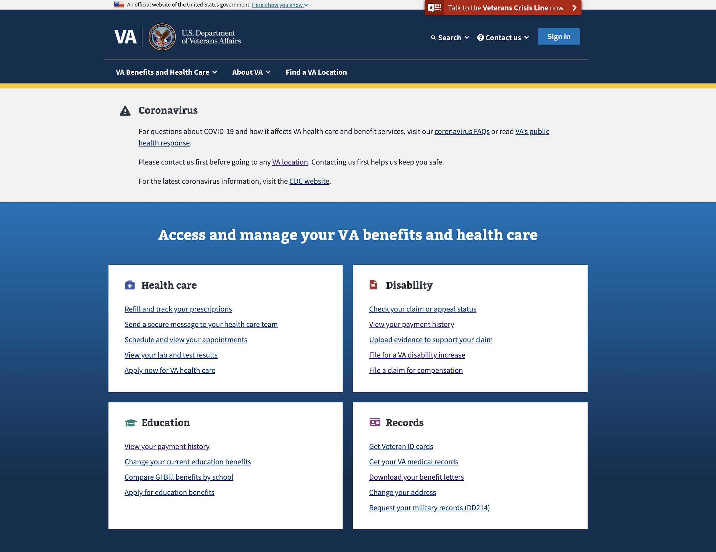
1. Veterans had different strategies for locating VA debt information online
Debt Letters MVP Usability
The blue hub area on the home page drew most attention, no participant ventured into the primary navigation.
Six participants stated that they’d look beneath the specific benefit hub.
Five participants narrowed in on ‘View your payment history’ under Disability.
2
3
1

Slide 13
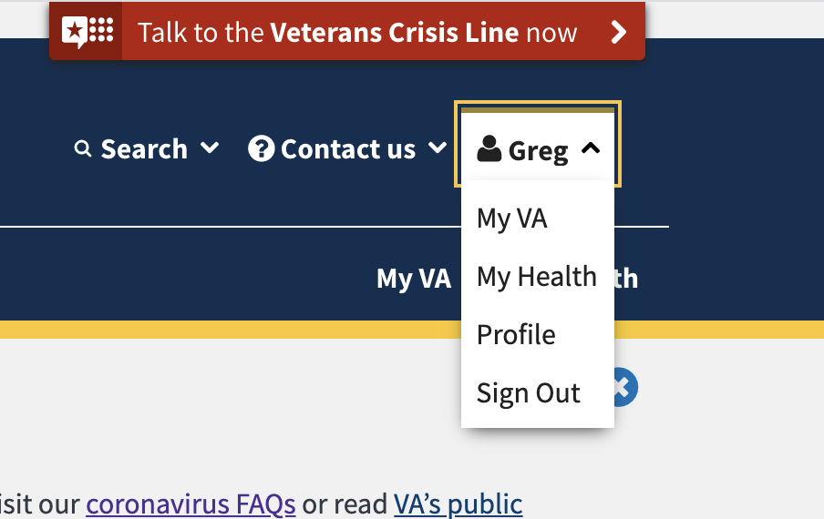
1. Veterans had different strategies for locating VA debt information online
Debt Letters MVP Usability
Three participants stated they’d look beneath the ‘Records’ hub.
Two participants stated that they’d expect the debt letters in their Profile or My VA.
Two participants stated that they would use the search feature.
One participant said they would specifically look for a ‘Financial’ hub.
6
5
4

Slide 14
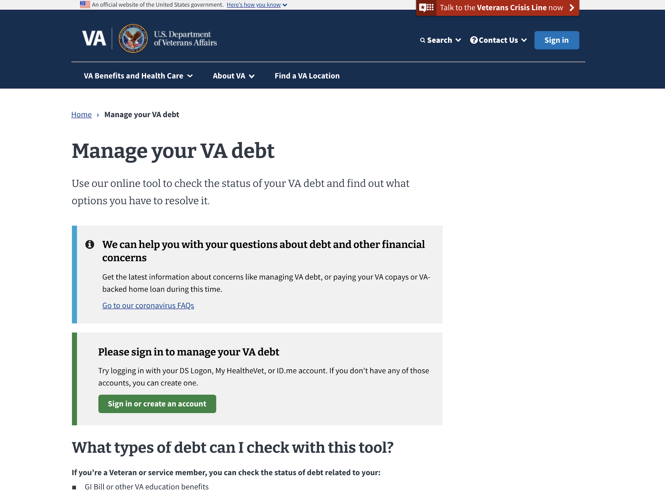
2. Participants commonly missed the sign-in alert and weren’t aware of the tool pathway
Debt Letters MVP Usability
Two participants signed in using the alert.
Two participants signed in with the blue global sign in.
Two participants had to be directed to click sign in to continue the test.
One participant asked, “sign into what?” in response to the alert.

Slide 15
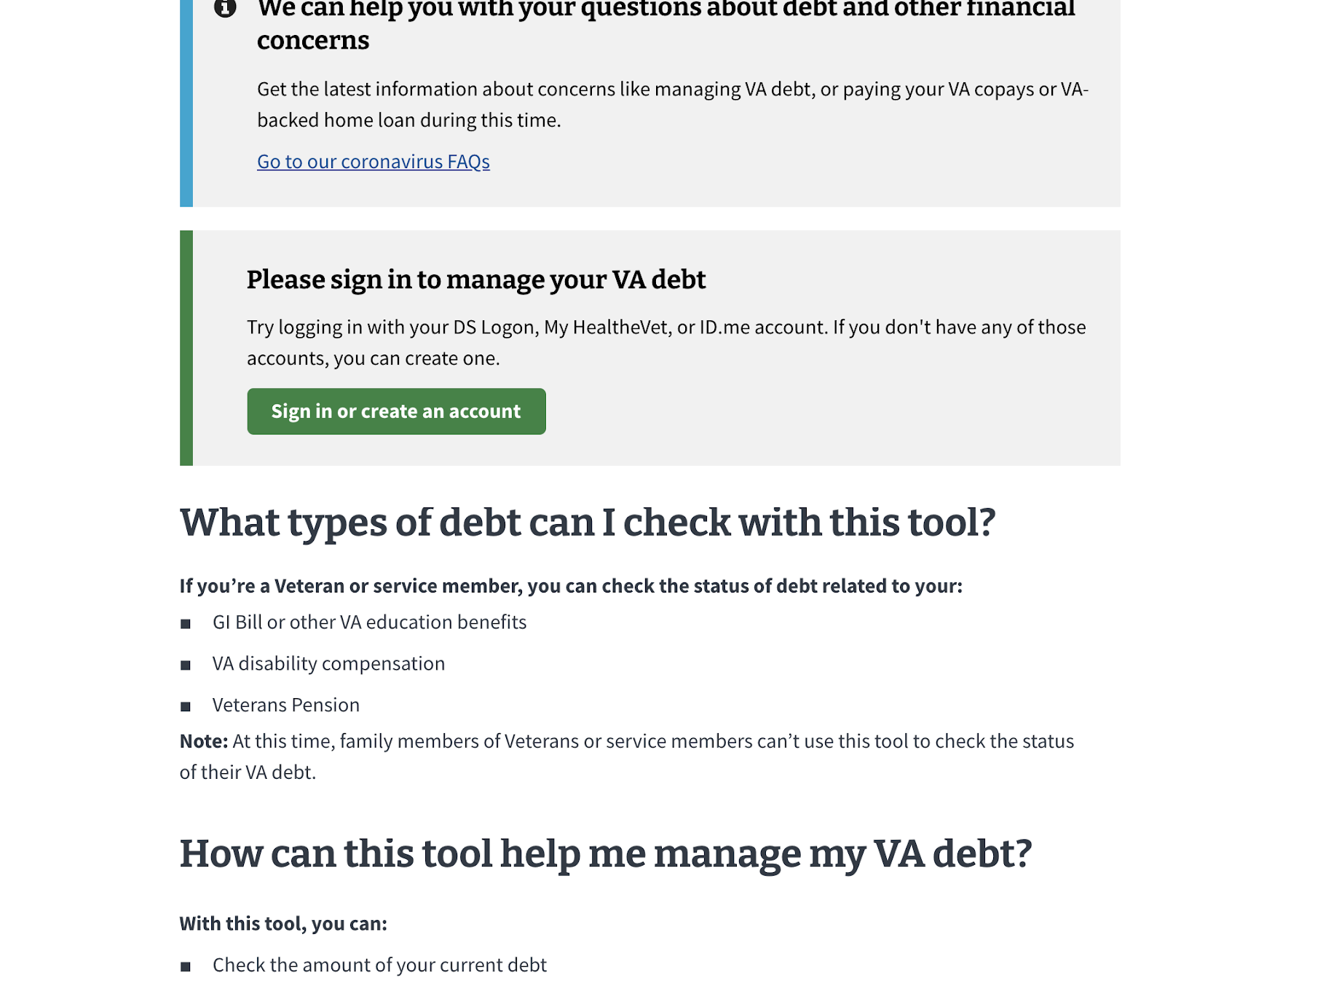
3. Participants quickly found the content about the types of debt included in the tool, but also expected all VA debts to be included
Debt Letters MVP Usability
When asked what debts they’d find in the tool, participants said:
School debt, disability, pension, and any health copays should be what's in there.
Uhm, well any debt that you owe the VA. It’s all kind of here, right?

Slide 16
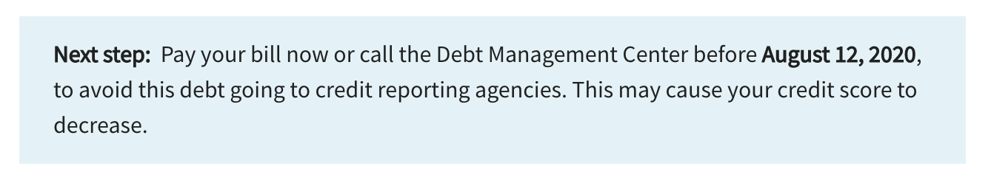
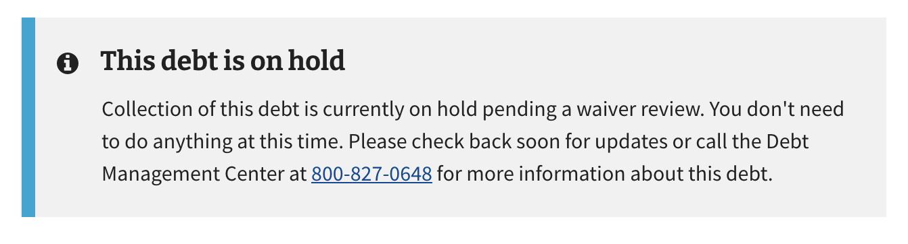
4. Participants liked the specificity of the status features and emphasized the importance of setting expectations by including dates
Debt Letters MVP Usability
That’s good. It tells me when I have to contact them by, so I know I have time.
Give me a timeframe. You don’t know how long. I have other things going on so I can’t think about that every single day. I need to know when I can expect something to change and when the ball is back in my court and it’s on me to do the next step.
Examples:
It’s tough because there’s no dates. It just says check back soon. How long does this process take? Should I be worrying that the waiver isn’t going to be approved?

Slide 17
5. Participants expected to see confirmation that their debts were fully repaid as well as have access to past debts
Debt Letters MVP Usability
Hopefully there’d be some history that I could log in and see this debt is now $0 or status is now ‘paid off.’ Something like that.
[I’d like a] ‘Congratulations, you did a good job!’ or at least a notification.

Slide 18
6. Many participants understood the cards and were satisfied with the information included in them — they did not feel drawn to click into the debt details immediately
Debt Letters MVP Usability
All participants quickly understood the statuses provided in the test cards and based their next action on that information.
One participant initially thought that each card represented a letter.
One participant thought that the cards were just an initial notification about the debt.
One participant said that she would have liked the “Updated [date]” to be more in line with the status, so it would read “First notification letter sent [date]”.

Slide 19
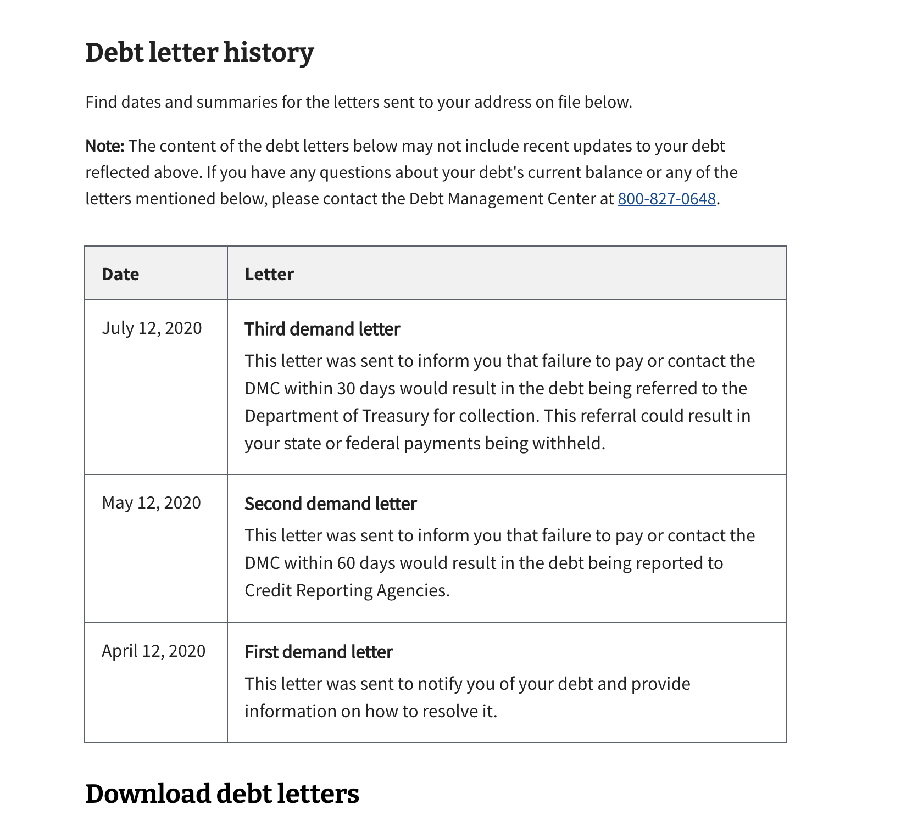
7. Several participants expected to see payment and debt history on the detail page
Debt Letters MVP Usability
I'm not seeing any payments made, just showing the amounts owed...
[I want,] at a later time, to be able to view my payment history.
I’d expect to see everything the VA knows about my debt! Really everything.

Slide 20
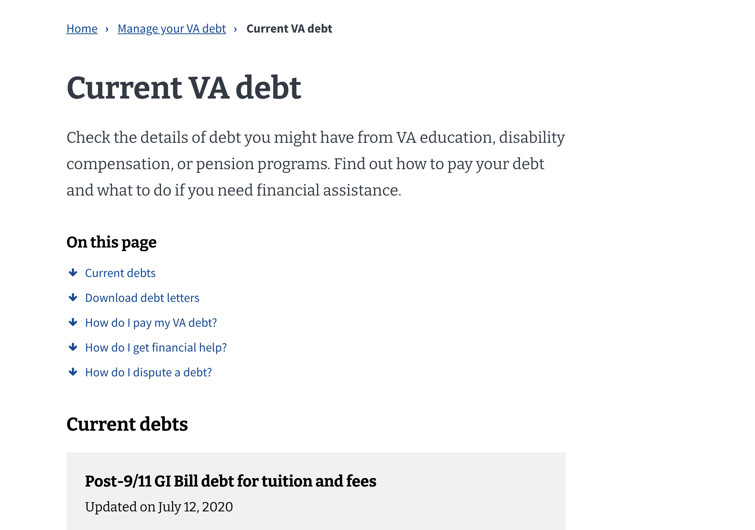
8. Most participants highly engaged with the ‘On this page’ component, and it helped them complete the usability tasks quickly
Debt Letters MVP Usability
The down arrow says ‘I'm gonna give you the answer’ when I click on it and it moves you down the page, which is good.
I like that under Current VA debt, it tells you what you can do on the page.

Slide 21
9. Veterans would prefer to fill out the Financial Status Report online
Debt Letters MVP Usability
I would prefer to have a link and potentially submit something as opposed to calling someone. I like the ease and the flexibility of being able to submit my own things online.
I would prefer to submit [the FSR] online because people seriously don't trust the mail and it's widely discussed how documents get lost.

Slide 22
10. Participants were overall satisfied with the letter download page, but several had difficulties navigating back to the debt summary list
Debt Letters MVP Usability

Slide 23
Additional Insights
Medical Device Tool Usability
Most participants stated that they typically log into VA.gov immediately if they’re on the website for a specific purpose.
Most participants were satisfied with the ‘Why might I have this debt?’ content; however, others felt it should be more specific.
Several participants negatively reacted to the term ‘Demand Letter’.
Several participants felt that “Compensation & Pension” was too vague and felt they should be split up.
Some participants thought the contents of the download table belonged to a single debt.
A couple of participants felt that Debt Management Center shouldn’t be abbreviated.
Several participants didn’t know what “Chapter 33” or “Chapter 34” were.

Slide 24
Recommendations

Slide 25
Short-term recommendations
Debt Letters MVP
Ensure that phone recommendations are clear to support what kind of debt a Veteran has as well as the kind of help they need.
Provide a confirmation when a debt is repaid with the option to save and print for their records.
Place VA debts under the future Profile or Logged in Homepage, but also supply links underneath each of the hubs.
Include more directly-worded buttons into the tool from the unauthenticated content page.
Be as specific as possible with ‘Next steps’ and statuses, provide dates or timelines where possible.
Adjust the debt cards to more closely pair status and date updated.
Provide a clearer navigation back to the debt list from the letter download page.
Notes:
Ideation sessions to determine features to implement
The insights gained from this research will influence the team’s ideation sessions. Our team will work with the DLC to determine what the product’s MVP looks like and uncover features that we would like to include. The design team will then begin creating wireframes and mockups following VA.gov design system’s form template.
Co-creation with Veterans
User research will continue to be woven into the design process so we may validate every step in the ordering process with Veterans who order hearing aid batteries and prosthetic socks.

Slide 26
Long-term recommendations
Debt Letters MVP
Provide as much self-service as possible, including online FSR.
Allow access to historical/past debts.
Consolidate all debt types into this tool, especially Medical Copay debts.
Incorporate debt letters into the debt detail pages.
Implement email or text notifications regarding debt updates.
Incorporate payment history into debt details.
Notes:
Ideation sessions to determine features to implement
The insights gained from this research will influence the team’s ideation sessions. Our team will work with the DLC to determine what the product’s MVP looks like and uncover features that we would like to include. The design team will then begin creating wireframes and mockups following VA.gov design system’s form template.
Co-creation with Veterans
User research will continue to be woven into the design process so we may validate every step in the ordering process with Veterans who order hearing aid batteries and prosthetic socks.

